Slide 1
Croup Clinical Care Guideline
Majid Keivanfar M.D
Pediatric Pulmonologist
Isfahan University Of Medical Sciences

Slide 2
Acute inflammatory process
Expressed as laryngotracheitis
Begins in the nasopharynx
Epithelium of larynx & trachea
Inflammation, and edema of the vocal folds

Slide 3
Stridor
rapid, turbulent flow of air through a narrowed segment of a large airway.
It is most often loud, with medium or low pitch, and inspiratory.
It usually originates from the larynx, upper trachea, or hypopharynx.
Progression of the disease process may make stridor softer, higher-pitched, and biphasic (inspiratory and expiratory).

Slide 4
The laryngeal anatomy of children makes them particularly susceptible to narrowing of the upper airways.
The larynx of a neonate is situated high in the neck, and the
epiglottis is narrow, omega-shaped , and vertically positioned.

Slide 5
The narrowest segment of the pediatric airway is the
subglottic region
encircled by the rigid cricoid cartilage ring.
There is nonfibrous, loosely attached mucosa

Slide 6
The diameter of the sub-glottis in a normal newborn is approximately 5 mm, and 0.5-mm edema in this region reduces the cross-sectional area to 64% of normal (area = π ∞ radius2). Air flow is directly proportional to the airway radius to the fourth power (Poiseuille's law), so a small reduction in caliber has a major effect on flow rate. The same 5-mm airway with 0.5 mm edema will have a flow rate of only 41% of baseline, assuming that pressure remains unchanged—a situation that is not necessarily the case if the Bernoulli principle is in play.

Slide 7
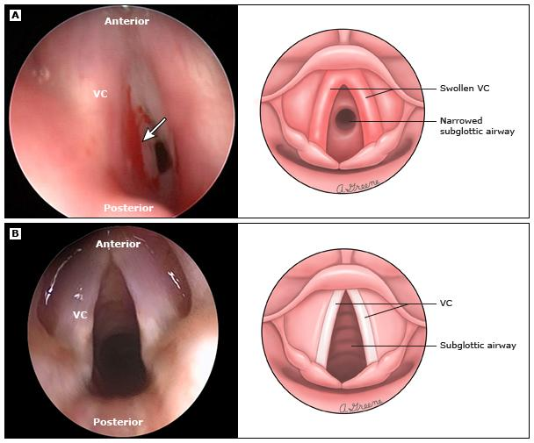

Slide 9
Etiology of Croup (Laryngotracheitis)
Parainfluenza type 1(most common) 2, 3
Influenza A & B
Human metapneumovirus (hMPV)
Measles virus
Respiratory syncitial virus (RSV)
Adenovirus
Rhinovirus
Mycoplasma pneumoniae
Enteroviruses
Herpes Simplex viruses
ReoViruses

Slide 10
Severity does not correlate with any particular etiologic agent.

Slide 11
Herpesviruses tend to cause a more severe and protracted form of the disease.
However, children hospitalized with influenzal croup tend to have longer hospitalization and greater risk of readmission for relapse of laryngeal symptoms.

Slide 12
Polymorphonuclear and monocytic leukocytes infiltrate the sub-epithelium
Vascular congestion and airway wall edema.
Spasmogenic mediators, decreased airway diameter.

Slide 13
This may result from a type I hypersensitivity response to PIV, and some authors have postulated a role for anti-PIV-specific (IgE) in the development of airway narrowing.

Slide 14
Host factors
Only a small fraction of children with a parainfluenza viral infection develop overt croup.
Congenital anatomic airway narrowing
Hyperactive airways
Acquired airway narrowing
Parainfluenza virus-specific (IgE)
Increased lymphoproliferative response

Slide 15
Age: 6 months to 3 yrs (Mean = 18 mos)
Duration: 3 to 7 days, symptoms maximal day 2 to3
Epidemiology: Year round; most common fall
Uncommon in children >6 years old
Male:female ratio 1.4:1

Slide 16
Clinical Progress
Day 1 to 3
Rhinorrhea
Sore throat
Low grade fever
Mild cough
Day 3 to 7
Onset symptoms of upper airway inflammation
Hoarseness
Barking cough
Stridor (variable)
Respiratory distress (variable)

Slide 17
History
●Fever – The absence of fever is suggestive of spasmodic croup or other noninfectious etiology
●Barking cough – The classic physical finding
●Hoarseness – Hoarseness may be present in croup
●Difficulty swallowing –acute epiglottitis. ingested foreign body in upper esophagus
●Drooling – peritonsillar or retropharyngeal abscesses, retropharyngeal cellulitis, and epiglottitis.
●Throat pain –more common in epiglottitis

Slide 18
Family history of croup is a risk factor for croup and recurrent croup.
3.2 times have an episode of croup
4.1 times to have recurrent croup.
Parental smoking, does not appear to increase the risk of croup !!

Slide 19
Emergency department visits for croup are most frequent between 10:00 PM and 4:00 AM.
However, children seen for croup between noon and 6:00 PM are more likely to be admitted to the hospital.

Slide 20
temperatures may reach 39–40°C
some children are afebrile

Slide 21
Croup is a disease of the upper airway, and alveolar gas exchange is usually normal.
Hypoxia and low oxygen saturation are seen only when complete airway obstruction is imminent.
The child who is hypoxic, cyanotic, pale, or obtunded needs immediate airway management.

Slide 23
Factors that are associated with increased severity of illness include:
●Sudden onset of symptoms
●Rapidly progressing symptoms (ie, symptoms of upper airway obstruction after fewer than 12 hours of illness)
●Previous episodes of croup
●Underlying abnormality of the upper airway
●Medical conditions that predispose to respiratory failure (eg, neuromuscular disorders)

Slide 24
Differential Diagnosis
Allergic reaction
Bacterial tracheitis
Epiglottitis
Foreign body aspiration
Hemangioma (subglottic)
Infectious mononucleosis
Laryngeal diptheria
Laryngeal nerve compression
Paraquat poisoning
Peritonsillar abscess
Retropharyngeal abscess
Subglottic stenosis
Trauma
Tumor \ intracranial process (rare)

Slide 25
Spasmodic croup
Allergic response to viral antigen
Acute non-inflammatory swelling
Acute nocturnal onset
Older child
Repeat attacks
Do not have coryzal prodrome
Afebrile
Links with atopy
Positive family history

Slide 26
Treatment is similar to that for viral LTB.
Some practitioners prescribe oral or inhaled corticosteroids to be kept at home and administered by the parents in case of an episode.

Slide 27
The etiology of recurrent, spasmodic croup remains unclear, suggested triggers include:
Gastro esophageal reflux
Anatomical abnormalities
Allergic predisposition
EOE

Slide 28
Additional studies
Plain lateral neck and
Chest radiographs
Computed tomography
Barium swallow and a pH study
Polysomnography

Slide 29
Rarer causes of recurrent stridor (e.g., hypocalcaemia or angioneurotic edema) are diagnosed by blood testing.
●Other potential mimickers of croup
Bronchogenic cyst (which can cause airway compression)
Guillain-Barré syndrome (involvement of the laryngeal nerve may cause vocal cord paralysis)

Slide 30
Laboratory and Radiology Studies
Diagnostic tests are only indicated if they will change outcome. Croup is a clinical diagnosis and usually no testing needed.

Slide 31
a posterior-anterior chest radiograph demonstrates subglottic narrowing, commonly called the "steeple sign" .
The lateral view may demonstrate overdistention of the hypopharynx during inspiration and subglottic haziness.

Slide 32
“steeple sign”
may be absent in patients with croup,
may be present as a normal variant,
may occasionally be present in epiglottitis

Slide 33
Plain Lateral Neck View
Rarely influences management
Wastes time
Can be dangerous
The neck extension can be fatal

Slide 34
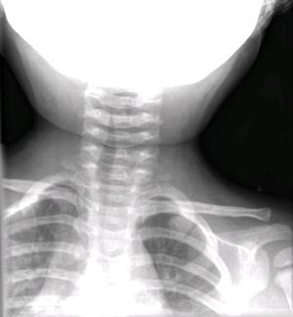

Slide 35
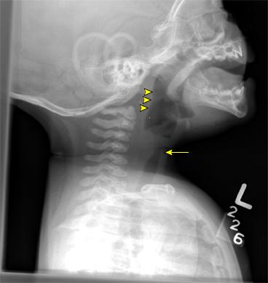

Slide 36
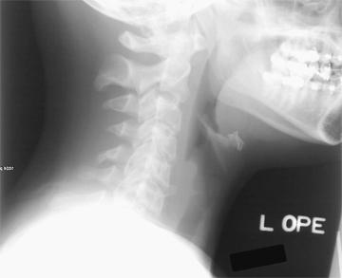

Slide 37
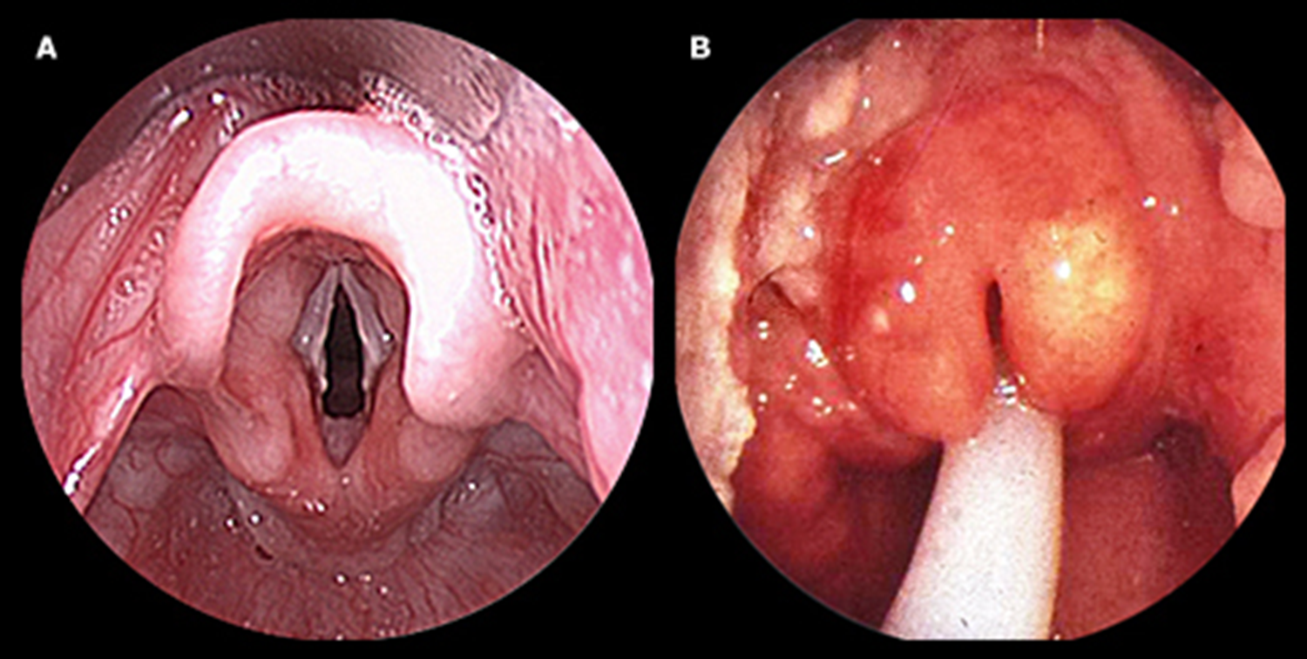

Slide 38
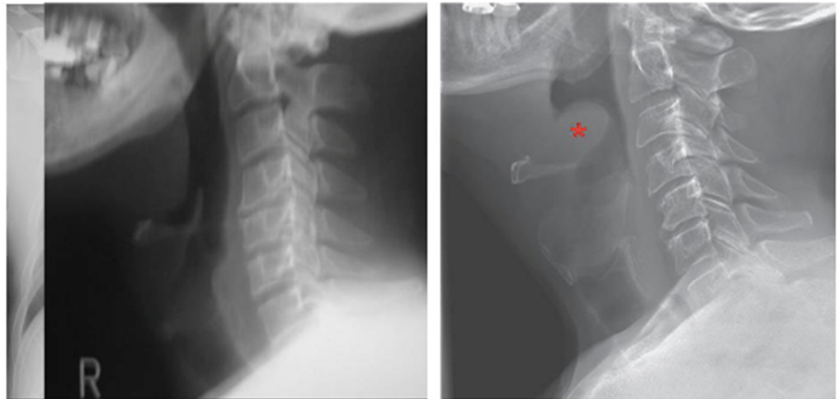

Slide 39
Monitoring
• Oxygen saturation (SaO2) usually normal in croup unless tracheitis present
• Continuous cardiac/pulse oximetry monitoring only recommended for unstable patient or receiving repeat nebulized epinephrine
• Follow vital signs to assess response to therapy: temperature, heart rate, respiratory rate

Slide 41
Therapeutics

Slide 42
Home treatment
In acute situations and for short periods of time, caregivers may try sitting with the child in a bathroom filled with steam generated by running hot water from the shower to improve symptoms. This may help reassure parents that "something" is being done to reverse the symptoms, and anecdotal evidence supports some benefit with this measure.

Slide 43
Corticosteroids
Dosing: Single Dose
Mechanism of action: Long lasting anti-inflammatory agent
Decrease edema in laryngeal mucosa
Adverse Effects:
Risk of progressive viral infection
Risk of secondary bacterial infection
Exacerbate active varicella or TB
Mask steroid dependant upper airway lesions (hemangioma)

Slide 44
• Dexamethasone
Dose: 0.15 to 0.6 mg/kg orally (preferred), IV, IM
Frequency:Once
Maximum Dose:16 mg
Peak serum levels:
Oral: Within 1 to 2 h
IM: within 8 h
Duration of action: 24 to 72 h

Slide 45
• Nebulized Budesonide 2mg [C]
Equal efficacy to dexamethasone; expensive
Consider in children with emesis or severe respiratory distress
• Prednisolone [C]
Dose: 1 mg/kg
• Prednisone [C]
Dose:
4 mg/kg/ (equivalent 0.6 mg/kg dexamethasone)
2 mg/kg/ (equivalent 0.3 mg/kg dexamethasone)
1 mg/kg/ (equivalent 0.15 mg/kg dexamethasone)

Slide 46
Repeated corticosteroid dosing
Are not necessary on a routine basis.
Moderate to severe symptoms that persist for more than a few days should prompt investigation for other causes of airway obstruction.

Slide 47
Nebulized Epinephrine
Mechanism of Action: Stimulation α-adrenergic receptors
Constrict capillary arterioles causing fluid resorption from interstitial space and decreases interstitial edema
Duration of action: less than or equal to 2 hours
Efficacy: Racemic & L-epinephrine are equally efficacious
Adverse effects: Myocardial Infarction (rare)

Slide 48
• Racemic Epinephrine
(1:1 mixture of δ & ϑ-isomers epinephrine)
Dose: 0.05 mL/kg/dose of 2.25% solution in 2.5mL normal saline (NS) via nebulizer over 15 minutes
Weight less than 5 kg = 0.25 mL
Weight greater than or equal to 5 kg = 0.5mL
Frequency: Repeat every 20 min as indicated
Maximum Dose: 0.5 mL

Slide 49
• L-epinephrine
Dose:
0.5 mL/kg/dose of 1:1000 L-epinephrine in 2.5 mL of NS via nebulizer over 15 min
Frequency:
Repeat every 15 to 20 minutes as indicated
Maximum Dose:
5 mL

Slide 50
The term ‘rebound phenomenon’ is a misnomer. Epinephrine doesn’t change the duration of croup and benefits lasts less than or equal to 2 hours.

Slide 51
It is safe to send children home from the ED after receiving racemic epinephrine if they have been observed for
a minimum of 3 hours post therapy .

Slide 52
Other therapies
• Mist: Humidified air with or without oxygen [C]
Controversial therapy without supporting evidence
May moisten airway secretions
May decreases airway inflammation
May decreases viscosity of tracheal mucus secretions enabling patient to remove them by coughing
May increase wheezing in laryngotracheitis-bronchitis\ pneumonitis

Slide 53
Mist therapy may provide a sense of comfort and reassurance to both the child and family.

Slide 54
• Anti-tussive or decongestant [C]
• Antibiotics [A]
No role in uncomplicated croup
Indicated only for bacterial component (tracheitis)
• Helium-Oxygen Mixture [B]
Not shown to be more effective than nebulized epinephrine
May be efficacious in patient with severe croup with impending respiratory failure.

Slide 55
CROUP SCORE
(Modified Westley)

Slide 56
Severity assessment
●Mild croup (croup score of ≤2) no stridor at rest
●Moderate croup (croup score of 3 to 7) stridor at rest
●Severe croup (croup score of ≥8) significant stridor at rest,

Slide 57
Impending respiratory failure (Westley croup score of ≥12) :
•Fatigue and listlessness
•Marked retractions
•Decreased or absent breath sounds
•Depressed level of consciousness
•Tachycardia out of proportion to fever
•Cyanosis or pallor

Slide 59
●Mild croup (croup score of ≤2) no stridor at rest
Home treatment:
Symptomatic care including antipyretics, mist, and oral fluids
Outpatient treatment:
Single dose of oral dexamethasone 0.15 to 0.6 mg/kg (maximum 16 mg)*

Slide 60
●Moderate croup (score of 3 to 7) should be evaluated in the emergency department or office
Single dose of oral dexamethasone 0.6 mg/kg (maximum 16 mg)*
Nebulized epinephrine
Hospitalization is generally not needed
Observe for 3 hrs . Discharge if indicated.

Slide 61
●Severe croup (score of ≥8) significant stridor at rest,
should be evaluated in the emergency department
Single dose of oral/IM/IV dexamethasone 0.6 mg/kg (maximum 16 mg)*
Repeated doses of nebulized epinephrine
Inpatient admission is generally required
Score<8? Observe for 3 hrs
Score>8? Repeat epinephrine>>PICU

Slide 62
Hospital admission
Patients with ongoing severe symptoms after initial treatment should receive additional nebulized epinephrine and should be admitted to the hospital.
Nebulized epinephrine can be repeated every 15 to 20 minutes. The administration of three or more doses within a two- to three-hour time period should prompt initiation of close cardiac monitoring if this is not already underway.

Slide 63
Admit ICU
•Consider for croup score greater than 8
•Escalating stridor at rest despite therapy
•Patient benefiting from ICU monitoring, treatment, or environment
•Any patient with impending respiratory failure:
o SaO2 less than 90% in 40% FiO2
o Cyanosis with supplemental oxygen

Slide 64
Oxygen should be administered to any child with severe airway obstruction, even in the absence of severe hypoxia, because it will aid respiratory muscle function.

Slide 65
Some children with severe croup either do not respond to the usual therapies or are too severely compromised at presentation to permit their use. These children require urgent endotracheal intubation and mechanical ventilation to avoid potentially catastrophic complete airway obstruction and the serious sequelae of hypoxia and hypercapnia .

Slide 66
Intubation should be performed by the most experienced person available, and it should be attempted with an uncuffed endotracheal tube one size smaller than the usual size for the child. Facilities for immediate tracheostomy must be available at the time of intubation

Slide 67
Most children without severe parenchymal involvement require respiratory support for 3 to 5 days. This is one context in which multiple rather than single doses of corticosteroids are often administered. The timing of extubation will depend on the development of an air leak, indicating resolution of airway narrowing. Re-intubation rates of approximately 10% have been reported.

Slide 68
Discharge Home
• Vital signs baseline
• Normal pulse oximetry
• Tolerating fluids by mouth
No stridor at rest
Good air exchange
Normal color
Caregivers understand instructions

Slide 69
Who Should Be Evaluated?

Slide 70
multiple episodes
severe or frequent
slow to resolve
absence of obvious infections

Slide 71
seven days?
Underlying airway abnormality
Complication of croup

Slide 72
PROGNOSIS
Symptoms of croup resolve in most children within three days but may persist for up to one week .
Approximately 8 to 15 percent of children with croup require hospital admission and among those, <3 percent require intubation . Mortality is rare, occurring in <1 percent of intubated children

Slide 73
Investigation is usually centered on airway endoscopy.
This must be performed in a unit and by an operator who is experienced in the technique because there is a risk in many of these conditions of exacerbating the airway obstruction.

Slide 74
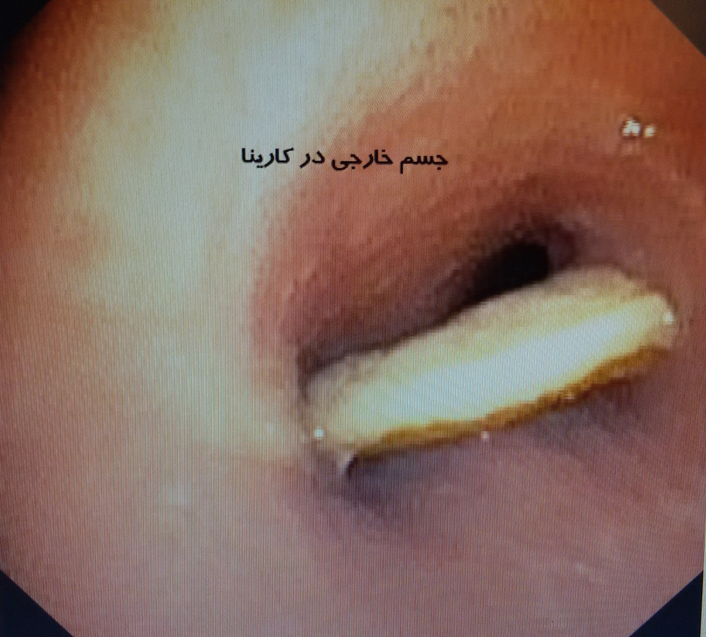

Slide 75
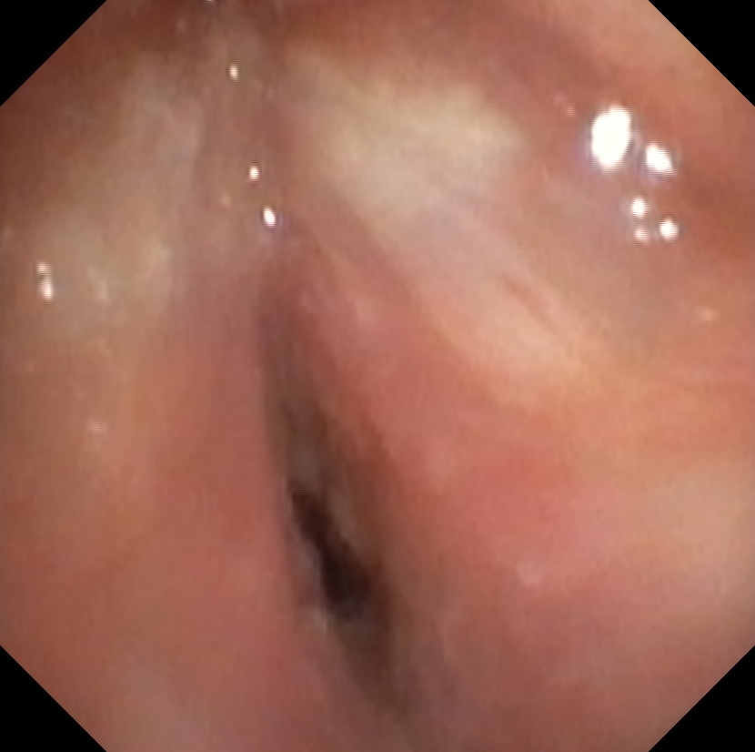

Slide 76
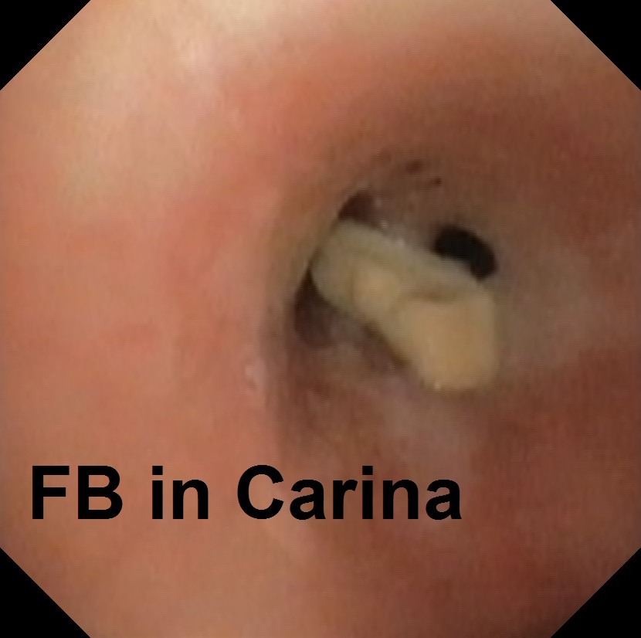

Slide 77
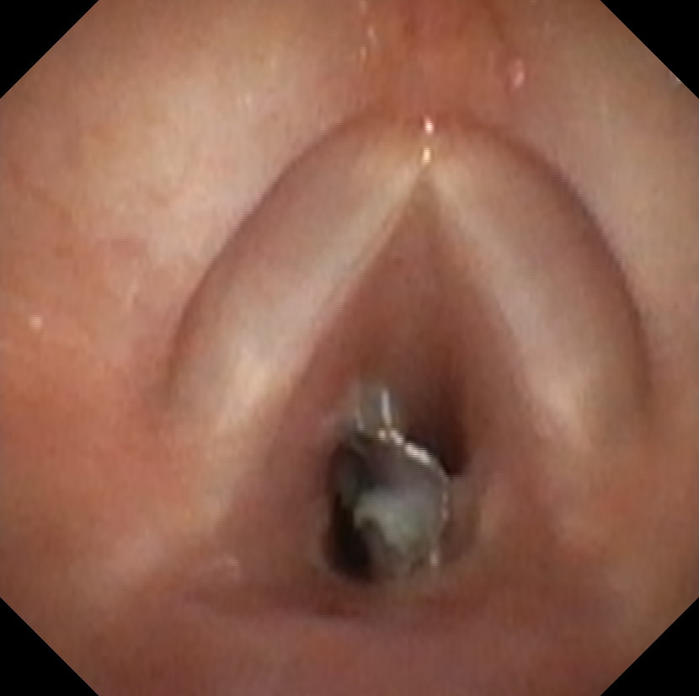

Slide 78
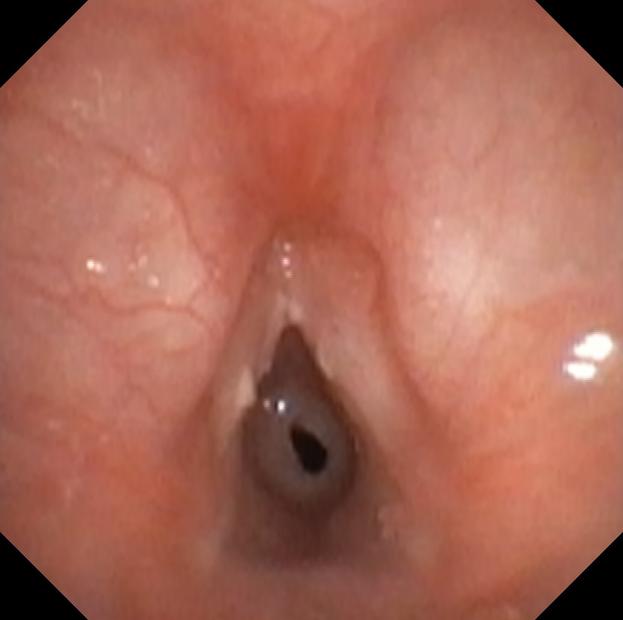

Slide 79
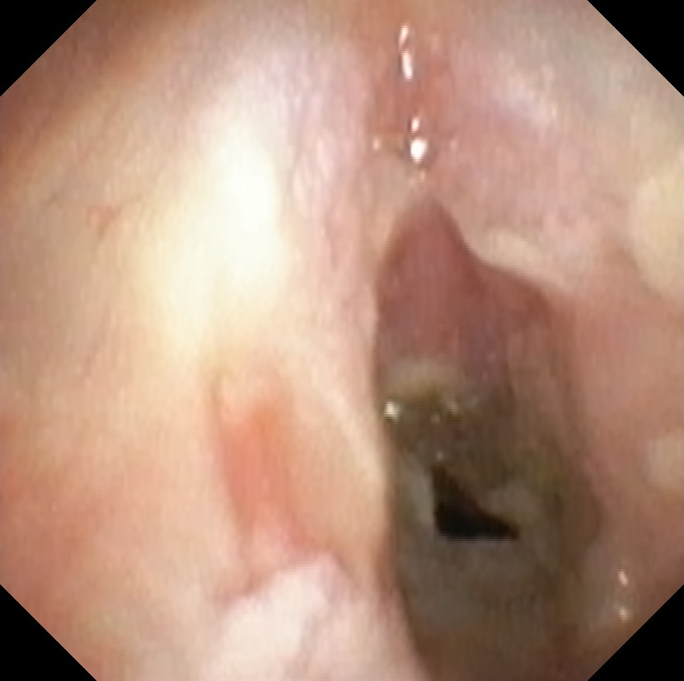

Slide 80
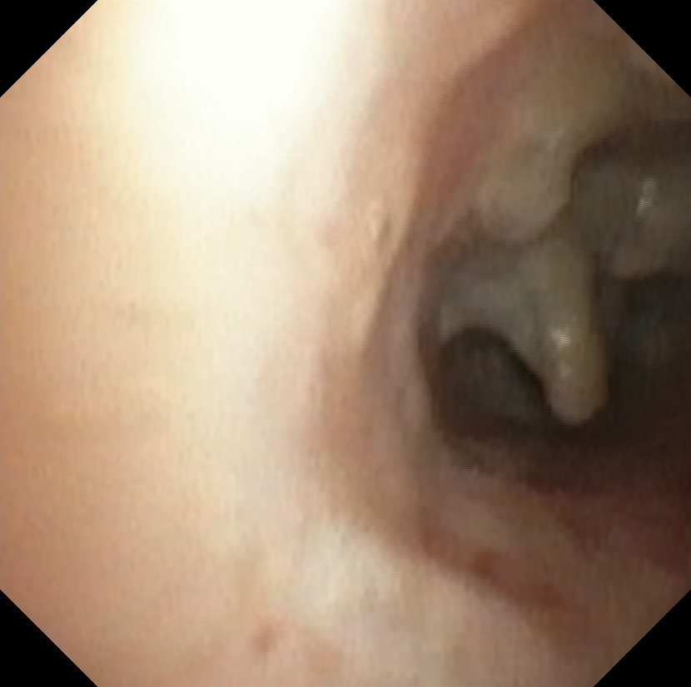

Slide 81
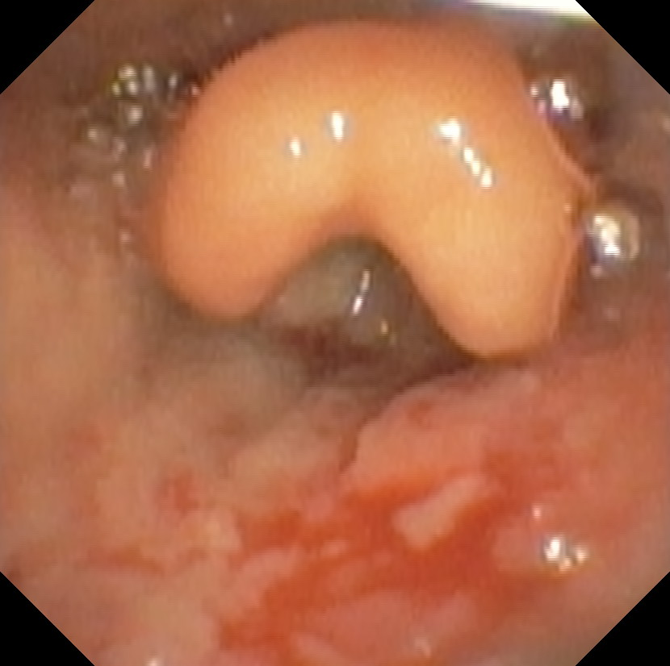
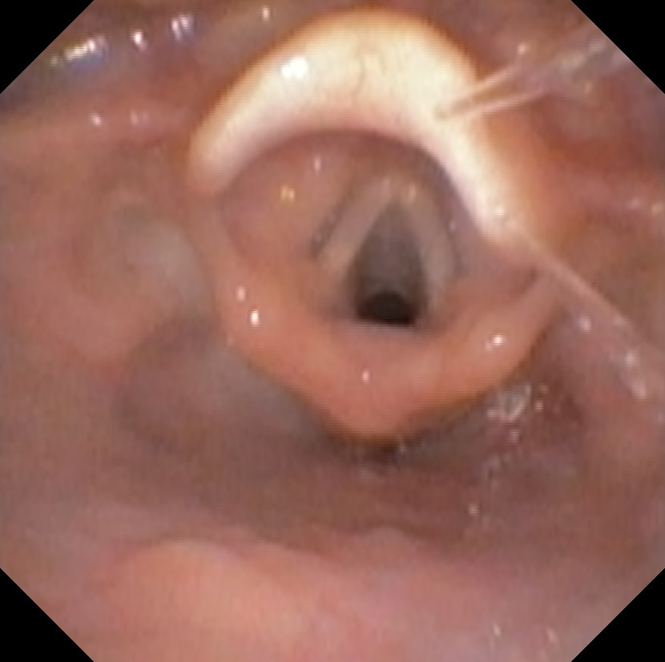

Slide 82
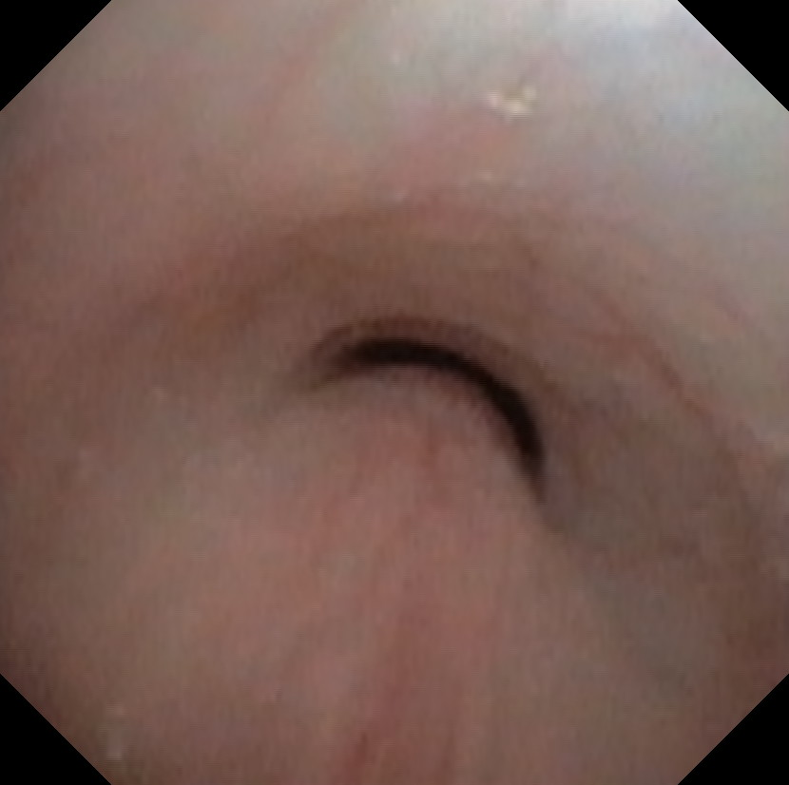

Slide 83
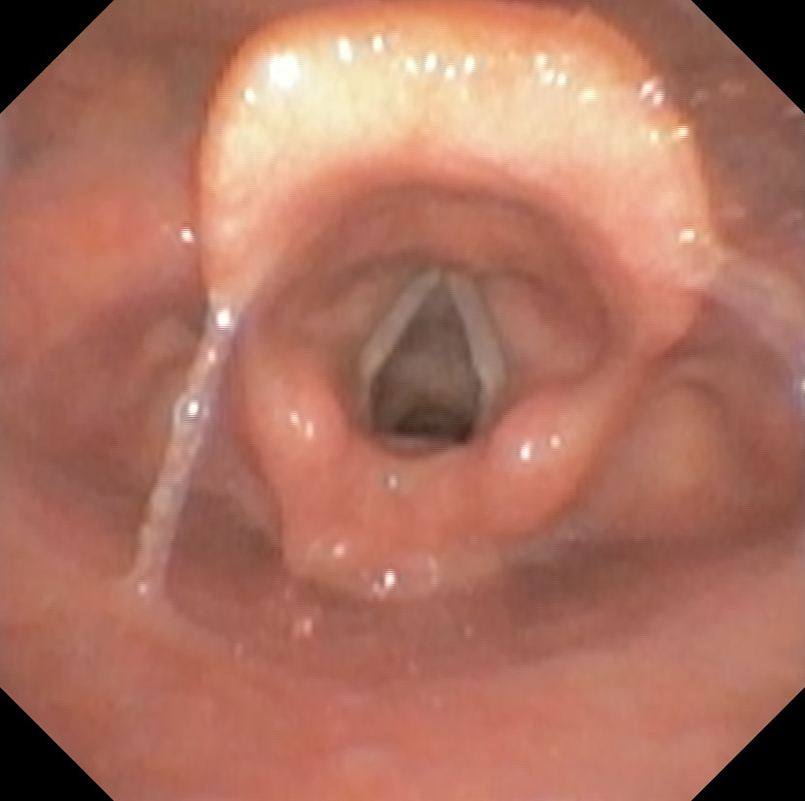
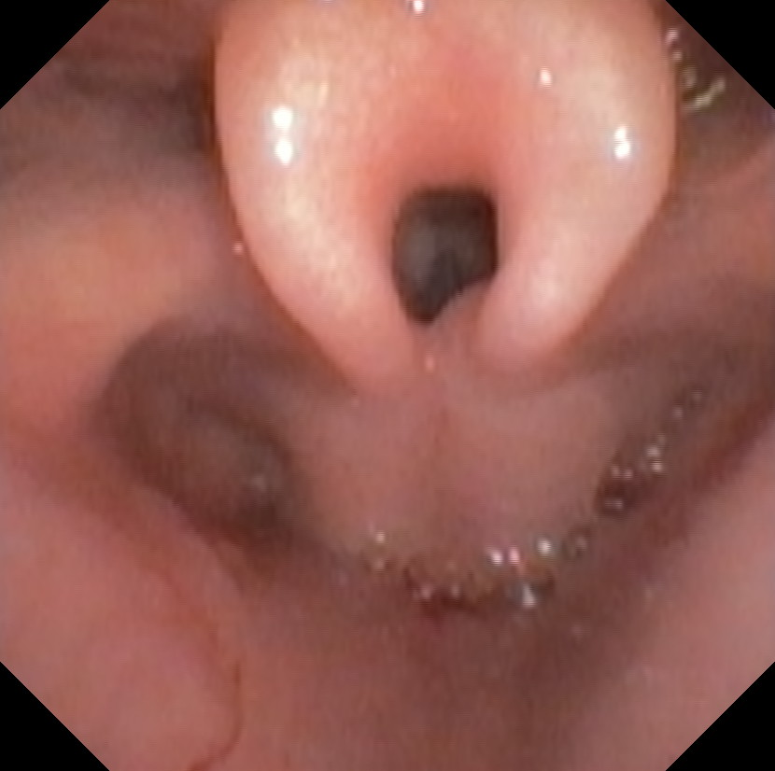

Slide 84
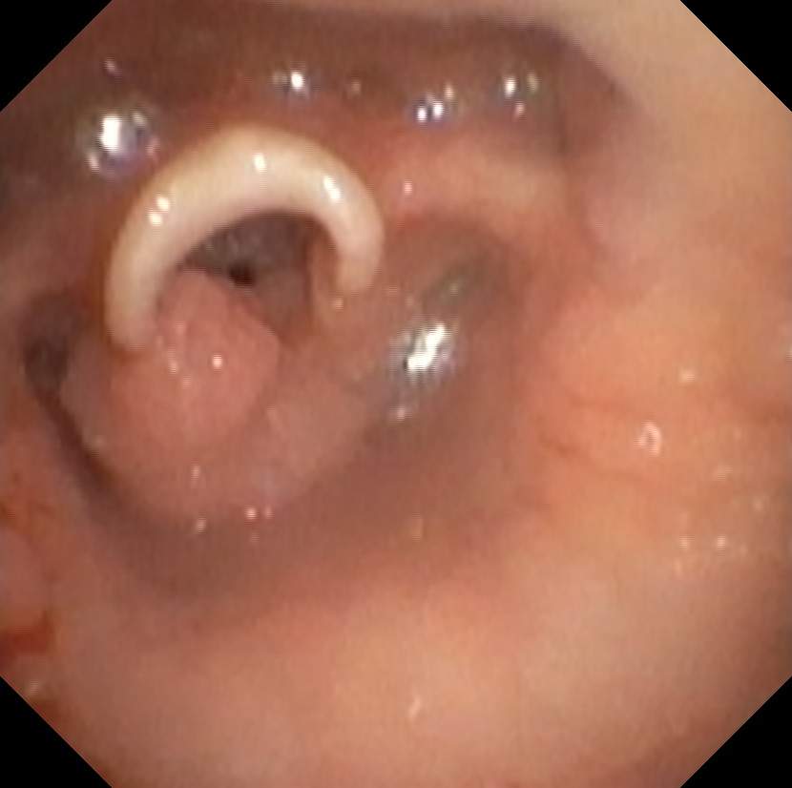

Slide 85
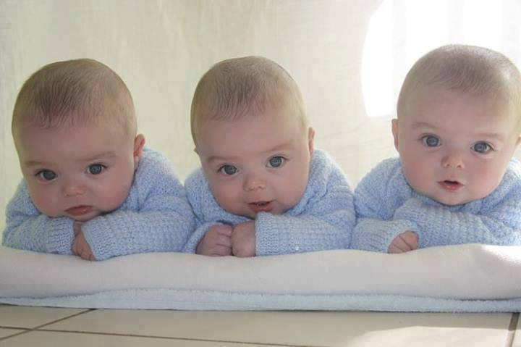
Thank you for your attention

