Slide 1
Pathophysiology of Diabetes Mellitus
M Siavash
Professor of endocrinology
Isfahan University of medical sciences
Summer 2021

Slide 2
Diabetes Mellitus
Glucose physiology and Insulin action
Definition of DM
Epidemiology, high risk group, screening
Classification
Etiology
Complications
Treatment
Metabolic syndrome

Slide 3
Glucose physiology and Insulin action
بدن انسان از سه نوع سوخت اصلی استفاده میکند:
گلوکز
چربی
پروتئین
از این میان گلوکز اهمیت خاصی دارد زیرا:
مغز برای زنده ماندن به آن وابسته است.
سریعتر از سایر سوختها در دسترس است.

Slide 4
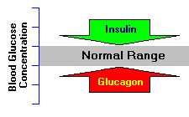
Glucose physiology
Regulatory
Counterregulatory
GH , Epinephrin , Cortisole

Slide 5
Glucose physiology and Insulin action
The brain in particular has an absolute dependence on glucose as a fuel, because neurons cannot utilize alternative energy sources like fatty acids to any significant extent .
When blood levels of glucose begin to fall below the normal range, it is imperative to find and pump additional glucose into blood .

Slide 6
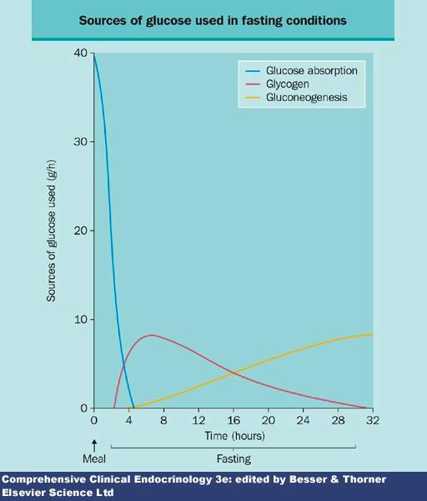
Glucose in fasting states

Slide 7
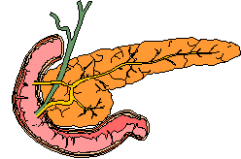
The Pancreas

Slide 8
The Pancreas

Slide 9
Functional Anatomy of the Endocrine Pancreas
The pancreas is an elongated organ nestled next to the first part of the small intestine.
The endocrine portion of the pancreas takes the form of many small clusters of cells called islets of Langerhans or, more simply, islets.
Humans have roughly one million islets.

Slide 10
Functional Anatomy of the Endocrine Pancreas
Pancreatic islets house three major cell types, each of which produces a different endocrine product:
Alpha cells (A cells) secrete the hormone glucagon.
Beta cells (B cells) produce insulin and are the most abundant of the islet cells.
Delta cells (D cells) secrete the hormone somatostatin, which is also produced by a number of other endocrine cells in the body.

Slide 11
Pancreas Histology

Slide 12
Functional Anatomy of the Endocrine Pancreas
Beta cells occupy the central portion of the islet and are surrounded by a "rind" of alpha and delta cells.
Islets are richly vascularized, allowing their secreted hormones ready access to the circulation.
Although islets comprise only 1-2% of the mass of the pancreas, they receive about 10 to 15% of the pancreatic blood flow.

Slide 13
Insulin secretion in beta cell
Glucose is the key regulator of insulin secretion by the pancreatic beta cell, although amino acids, ketones, various nutrients, gastrointestinal peptides, and neurotransmitters also influence insulin secretion.
Glucose levels >3.9 mmol/L (70 mg/dL) stimulate insulin synthesis, primarily by enhancing protein translation and processing, as well as inducing insulin secretion.

Slide 14
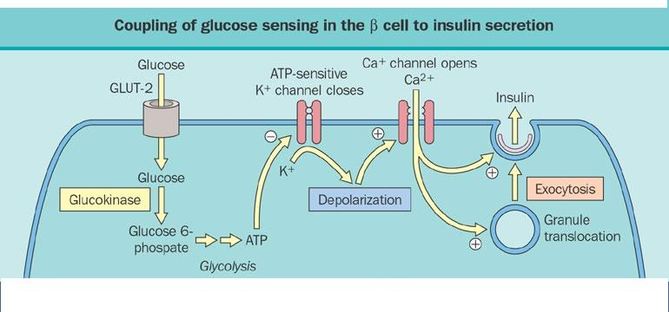
Insulin secretion in beta cell

Slide 15
Insulin secretion in beta cell

Slide 16
Insulin structure

Slide 17
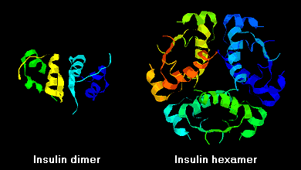
Insulin structure

Slide 18
Insulin secretion in beta cell
Careful studies of insulin secretory profiles reveal pulsatile pattern of hormone release, with small secretory bursts occurring about every 10 min, superimposed upon greater amplitude oscillations of about 80 to 150 min.
Meals or other major stimuli of insulin secretion induce large (four- to fivefold increase versus baseline) bursts of insulin secretion that usually last for 2 to 3 h before returning to baseline.
Derangements in these normal secretory patterns are one of the earliest signs of beta cell dysfunction in DM.

Slide 19
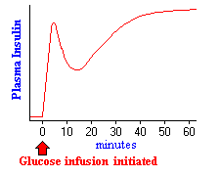
Insulin secretion in beta cell

Slide 20
Normal endogenous insulin secretion

Slide 21
Effects of Insulin
Insulin facilitates entry of glucose into muscle, adipose and several other tissues.
Insulin stimulates the liver to store glucose in the form of glycogen.
Insulin promotes synthesis of fatty acids in the liver.
Insulin inhibits breakdown of fat in adipose tissue.
Insulin stimulates the uptake of amino acids, again contributing to its overall anabolic effect.
Insulin also increases the permeability of many cells to potassium, magnesium and phosphate ions.

Slide 22
Effects of Insulin

Slide 23
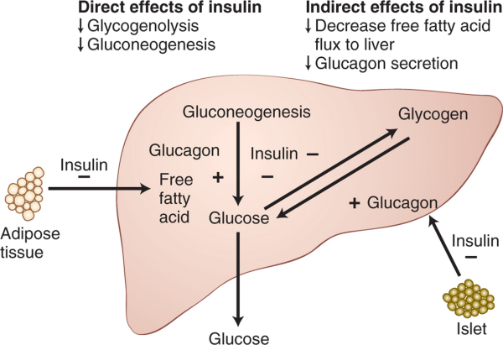
Effects of Insulin

Slide 24
Effects of Insulin
Insulin suppresses hepatic glucose production by direct and indirect mechanisms.
In insulin resistance, insulin's ability to suppress lipolysis in adipose tissue and glucagon secretion by alpha cells in the islet results in increased gluconeogenesis.
In addition, insulin inhibition of glycogenolysis is impaired. Thus, both hepatic and peripheral insulin resistance results in abnormal glucose production by the liver.

Slide 25
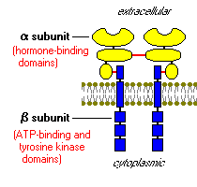
Insulin Receptor

Slide 26
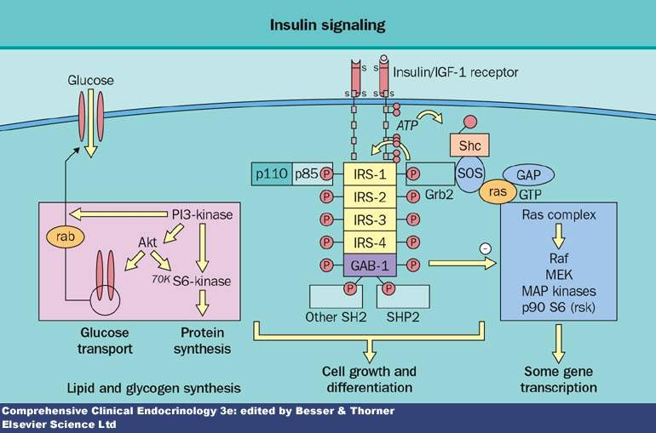
Insulin action in cells

Slide 27
Diabetes mellitus
Diabetes mellitus is a group of metabolic diseases characterized by hyperglycemia resulting from defects in insulin secretion, insulin action, or both.
The chronic hyperglycemia of diabetes is associated with long-term damage, dysfunction, and failure of various organs, especially the eyes, kidneys, nerves, heart, and blood vessels.

Slide 29
Epidemiology
The worldwide prevalence of DM has risen dramatically over the past two decades, from an estimated 30 million cases in 1985 to 177 million in 2000.
Based on current trends, >360 million individuals will have diabetes by the year 2030 .
Although the prevalence of both type 1 and type 2 DM is increasing worldwide, the prevalence of type 2 DM is rising much more rapidly because of increasing obesity and reduced activity levels as countries become more industrialized.
7% of the population, had diabetes in 2005 (~30% of individuals with diabetes were undiagnosed).

Slide 30
Epidemiology
Type 2 diabetes mellitus (T2DM) is the predominant form of diabetes worldwide, accounting for 90% of cases globally.
Type 2 diabetes is currently thought to occur in genetically predisposed persons who are exposed to a series of environmental influences that precipitate the onset of clinical disease.
Sex, age, and ethnic background are important factors in determining risk of developing T2DM.
Diabetes is a major cause of mortality, but several studies indicate that diabetes is likely underreported as a cause of death.

Slide 31
Epidemiology
In type 1 DM
Less than 10% of DM
More common in children
Increasing in north Europe
In type 2 DM
11% of Adult population
Increasing in all the world

Slide 32
Pathogenesis of Type 1 diabetes mellitus
GENETIC SUSCEPTIBILITY
MHC genes
Non-MHC genes
AUTOIMMUNITY
Target autoantigens
Glutamic acid decarboxylase
Insulin
Insulinoma-associated protein 2
Role of cellular immunity
ENVIRONMENTAL FACTORS
Perinatal factors
Role of viruses
Role of diet

Slide 33
Pathogenesis of Type 1 diabetes mellitus
T1DM, also known as type 1A DM or as per the previous nomenclature as insulin-dependent diabetes mellitus (IDDM) or juvenile-onset diabetes, constitutes about 5–10% of all the cases of diabetes.
It is an autoimmune disorder characterized by T-cell-mediated destruction of pancreatic β-cells, which results in insulin deficiency and ultimately hyperglycemia.

Slide 34
Pathogenesis of Type 1 diabetes mellitus
T1DM is an autoimmune disorder characterized by several immune markers, in particular autoantibodies.
These autoantibodies are associated with the immune-mediated β-cell destruction, characteristic of this disease.
The autoantibodies include:
glutamic acid decarboxylase autoantibodies (GADAs) such as GAD65,
islet cell autoantibodies (ICAs) to β-cell cytoplasmic proteins such as autoantibodies to islet cell antigen 512 (ICA512),
autoantibodies to the tyrosine phosphatases, IA-2 and IA-2α,
insulin autoantibodies (IAAs), and
autoantibodies to islet-specific zinc transporter isoform 8 (ZnT8).

Slide 35
Pathogenesis of Type 2 diabetes mellitus
GENETIC SUSCEPTIBILITY
Genes affecting insulin release
Genes affecting insulin action
ENVIRONMENTAL FACTORS
Role of diet and obesity
Free fatty acids
Tumor necrosis factor-alpha
Adiponectin
Resistin
Uncoupling protein 2
Pattern of fat distribution
Role of intrauterine development and birth weight

Slide 36
PATHOPHYSIOLOGY of type 2 diabetes mellitus
This type of diabetes is characterized by two main insulin-related anomalies: insulin resistance and β-cell dysfunction.
Insulin resistance results from disruption of various cellular pathways, which lead to a decreased response, or sensitivity of cells in the peripheral tissues, in particular the muscle, liver, and adipose tissue toward insulin.

Slide 37
PATHOPHYSIOLOGY of type 2 diabetes mellitus
In the early stages of the disease, decreased insulin sensitivity triggers β-cells hyperfunction to achieve a compensatory increase in insulin secretion to maintain normoglycemia.
The higher levels of circulating insulin (hyperinsulinemia), thus, prevent hyperglycemia.
However, gradually, the increased insulin secretion by β-cells is not able to compensate sufficiently for the decrease in insulin sensitivity.
Moreover, β-cell function begins to decline and β-cell dysfunction eventually leads to insulin deficiency.

Slide 38
Insulin resistance

Slide 39
Thank you and hope for a good rain

